Slide 1
CS 367-305/306/307
Recitation 10 – Y86-64/Logic Gates

Slide 2
Y86-64
Say we have the following encoding
What’s the first instruction?
What about the next one?
60 | 76 | 90 | 00 | 00 | 00 | 00 | 00

Slide 3
Y86-64
Say we have the following encoding
What’s the first instruction?
addq
What about the next one?
60 | 76 | 90 | 00 | 00 | 00 | 00 | 00

Slide 4
Y86-64
Say we have the following encoding
What’s the first instruction?
addq %rdi, %rsi;
What about the next one?
60 | 76 | 90 | 00 | 00 | 00 | 00 | 00

Slide 5
Y86-64
Say we have the following encoding
What’s the first instruction?
addq %rdi, %rsi;
What about the next one?
retq;
60 | 76 | 90 | 00 | 00 | 00 | 00 | 00

Slide 6
Y86-64
X86-64
Y86-64 equivalent
cmpq %rax, %rdi
jl L2
Memory Encoding
0x400000

Slide 7
Y86-64
X86-64
Y86-64 equivalent
cmpq %rax, %rdi
jl L2
rrmovq %rdi, %rcx subq %rax, %rcx
Memory Encoding
0x400000

Slide 8
Y86-64
X86-64
Y86-64 equivalent
cmpq %rax, %rdi
jl L2
rrmovq %rdi, %rcx subq %rax, %rcx
jl L2
Memory Encoding
0x400000

Slide 9
Y86-64
X86-64
Y86-64 equivalent
cmpq %rax, %rdi
jl L2
rrmovq %rdi, %rcx subq %rax, %rcx
jl L2
Memory Encoding
0x400000 20 71

Slide 10
Y86-64
X86-64
Y86-64 equivalent
cmpq %rax, %rdi
jl L2
rrmovq %rdi, %rcx subq %rax, %rcx
jl L2
Memory Encoding
0x400000 20 71
0x400002 61 01

Slide 11
Y86-64
X86-64
Y86-64 equivalent
cmpq %rax, %rdi
jl L2
rrmovq %rdi, %rcx subq %rax, %rcx
jl L2
Memory Encoding
0x400000 20 71
0x400002 61 01
0x400004 72 10 00 40 00 00 00 00 00 #if L2 starts at 0x400010, for example

Slide 12
Y86-64
X86-64
Y86-64 equivalent
cmpq %rax, %rdi
jl L2
rrmovq %rdi, %rcx subq %rax, %rcx
jl L2
Memory Encoding
0x400000 20 71
0x400002 61 01
0x400004 72 10 00 40 00 00 00 00 00 #if L2 starts at 0x400010, for example
0x40000d … #jl took 9 bytes, so the next starting address is 0x400004 + 9

Slide 13
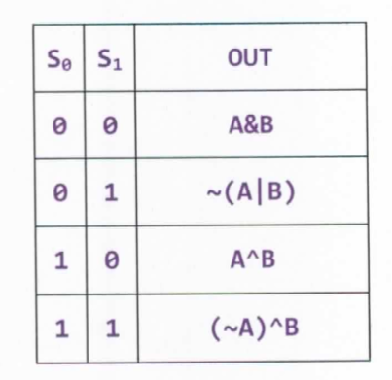
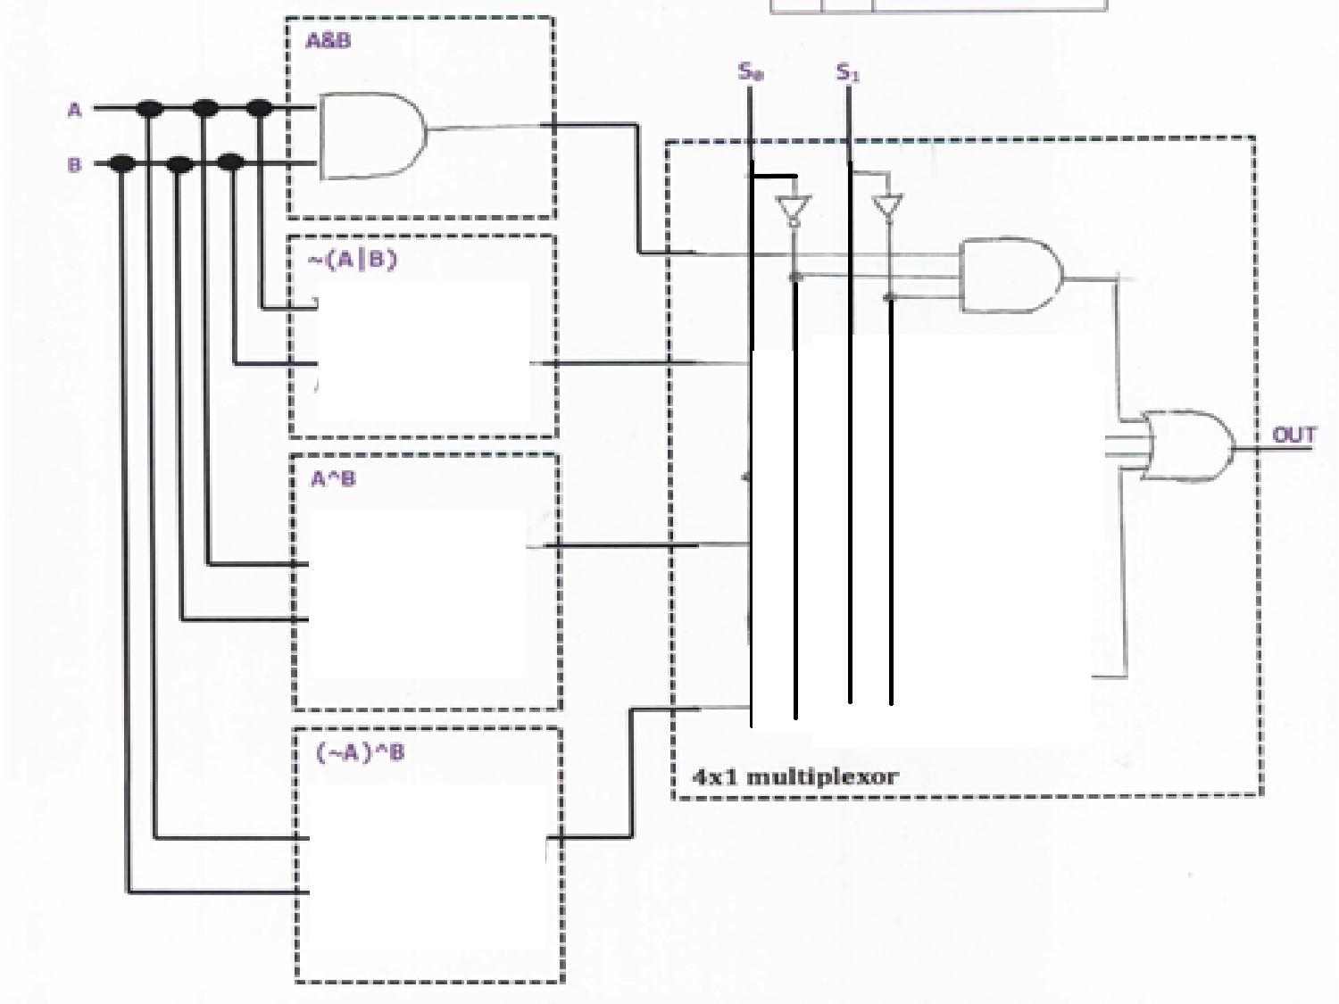
Logic Gates

Slide 14
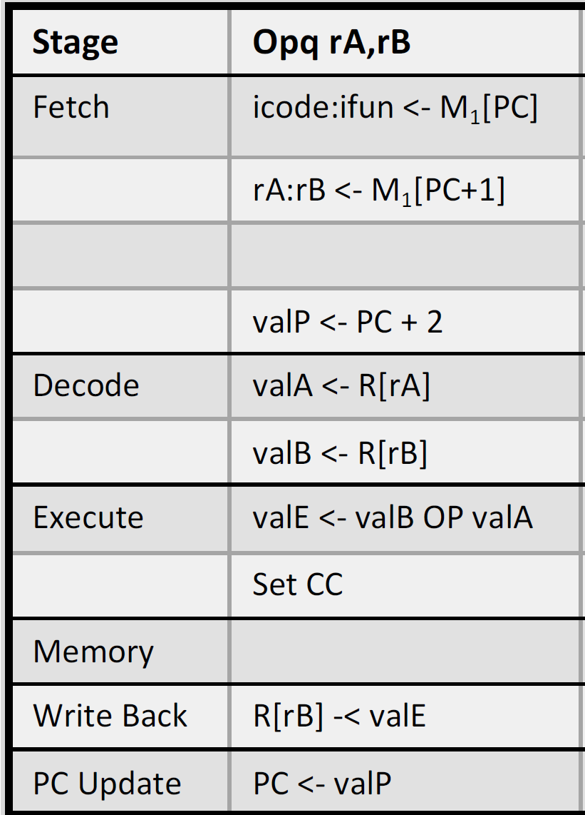
Y86-64 CPU Stages
M[0x110]
M[0x111]
61 | 67
Stage | subq %rsi, %rdi
Fetch
Decode
Execute
Memory
Write Back
PC Update

Slide 15
Y86-64 CPU Stages
M[0x110]
M[0x111]
61 | 67
Stage | subq %rsi, %rdi
Fetch | icode:ifun <- 6:1 rA:rB <- 6:7 valP <- 0x112
Decode
Execute
Memory
Write Back
PC Update

Slide 16
Y86-64 CPU Stages
M[0x110]
M[0x111]
61 | 67
Stage | subq %rsi, %rdi
Fetch | icode:ifun <- 6:1 rA:rB <- 6:7 valP <- 0x112
Decode | valA <- R[%rsi] = 8 valB <- R[%rdi] = 16
Execute
Memory
Write Back
PC Update

Slide 17
Y86-64 CPU Stages
M[0x110]
M[0x111]
61 | 67
Stage | subq %rsi, %rdi
Fetch | icode:ifun <- 6:1 rA:rB <- 6:7 valP <- 0x112
Decode | valA <- 8 valB <- 16
Execute | valE <- 16 – 8 = 8 ZF=0, SF=0, OF=0
Memory
Write Back
PC Update

Slide 18
Y86-64 CPU Stages
M[0x110]
M[0x111]
61 | 67
Stage | subq %rsi, %rdi
Fetch | icode:ifun <- 6:1 rA:rB <- 6:7 valP <- 0x112
Decode | valA <- 8 valB <- 16
Execute | valE <- 8 ZF=0, SF=0, OF=0
Memory
Write Back | R[%rdi] <- 8
PC Update

Slide 19
Y86-64 CPU Stages
M[0x110]
M[0x111]
61 | 67
Stage | subq %rsi, %rdi
Fetch | icode:ifun <- 6:1 rA:rB <- 6:7 valP <- 0x112
Decode | valA <- 8 valB <- 16
Execute | valE <- 8 ZF=0, SF=0, OF=0
Memory
Write Back | R[%rdi] <- 8
PC Update | PC <- 0x112

Slide 20
Y86-64 CPU Stages
M[0x110]
M[0x111]
61 | 67
Stage | subq %rsi, %rdi
Fetch | icode:ifun <- 6:1 rA:rB <- 6:7 valP <- 0x112
Decode | valA <- 8 valB <- 16
Execute | valE <- 8 ZF=0, SF=0, OF=0
Memory
Write Back | R[%rdi] <- 8
PC Update | PC <- 0x112

